Slide 1
Energy Resources
Dr. Vinayak V. Pathak
Department of Chemistry
Manav Rachna University

Slide 2
Energy resources
Energy resources are all forms of fuels used in the modern world, either for heating, generation of electrical energy, or for other forms of energy conversion processes.
Energy resources can be classified as renewable and non renewable energy resources Renewable energy resources can be replenished or regenerated in short duration while non renewable resources are limited in quantity and prone to extinction due to their intensive exploitation.
Energy is the key driver of our ecosystem which is received from the sun and transferred to other trophic levels.
Energy is required to perform day to day activities, industrial operations, transportation etc.

Slide 3
Growing energy needs
Approximately 80% of the world’s energy is produced by fossil fuels.
World demand for oil (according to UN reports) rose from 436 million tonnes in 1960 to 2189 million tonnes in 1970 and to 3200 million tonnes in 1999. In 2019 the global demand of oil was 100.1 billion barrel per day.
Coal fired thermal power plants generate about 72% of electricity generation I India.
India consumes about 96,62,88693 tonnes of coal per year.

Slide 4
Total population of India =1.21 billion
Rural population = 70% of total
396 million of the rural population do not have access to electricity.
592 million population still used firewood for cooking.
Majority of the rural people dependent on non commercial energy resources.
80 % of the total population still relies combustion of biomass to accomplish the cooking fuel requirements.
Combustion of biomass causes indoor air pollution which caused 488200 deaths in 2004.

Slide 5

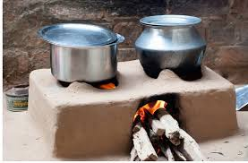
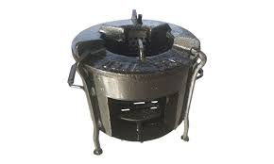
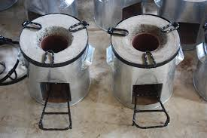

Slide 6
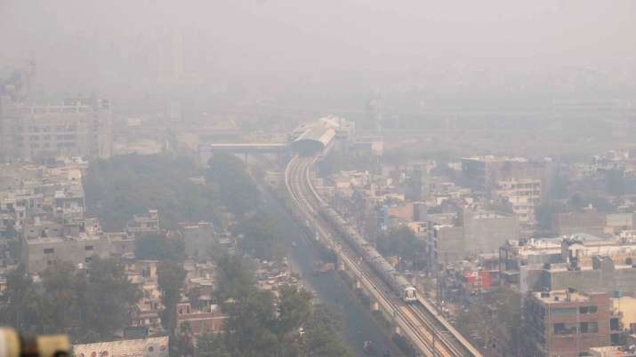
Conventional energy and atmospheric pollution
A new study has found that air pollution from fossil fuels is responsible for nearly one in every five deaths worldwide.
According to the research, exposure to fine particulate matter, or PM 2.5, from burning fossil fuels was responsible for about 8.7 million deaths globally in 2018.

Slide 7
Renewable energy
India has huge potential for generation of renewable energy.
the total installed capacity of grid connected renewable energy is 23.12 GW.
Amongst this, the biggest chunk is from wind power, which stands at around 16, 000 MW. The wind energy sector is continuously increasing and around 2100 MW of wind power was added last year and is expected to continue because of the continued government supported schemes in this sector.

Slide 8
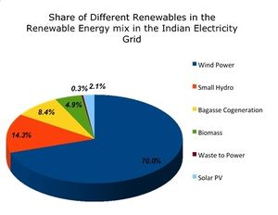

Slide 9
Solar Energy
Solar energy is radiant light and heat from the Sun that is harnessed using a range of ever-evolving technologies such as solar heating, photovoltaics, solar thermal energy, solar architecture, molten salt power plants and artificial photosynthesis.
India has high Solar Insolation levels with about 300 clear sunny days –most parts of the country receive 4-7 Kwh/m²/day with about 1500-2000 sunshine hours per-week (depending upon location ) , which is far more than current total energy consumption .
Ministry of New and Renewable energy (MNRE), Government of India estimates solar potential at over 10000 MW. States on West part of India such as Rajasthan and Gujrat have the highest potential. Parts of these states have the best solar irradiance in India with 4-7 Kwh/m²/day.

Slide 10
Wind power
Air in motion is termed as Wind. Wind energy generation involves conversion of kinetic energy of wind in to electricity using MHD generator installed in a wind mill.
Developing of wind power in India was initiated by Maneklal sankalchand in 1952 through a project on exploring the possibilities of harnessing wind power in country.
As of 30 September 2020, the total installed wind power capacity was 38.124 GW, the fourth largest installed wind power capacity in the world.
Tamilnadu holds first rank in highest wind power generation followed by Gujrat, Maharashtra, Karnatka, Rajasthan, Andhrapradesh.

Slide 11
Hydroelectric power
India is the 5th globally for installed hydro power capacity.
As on March 2020, total installed capacity of hydropower was about 46000 W (12.3%).
The hydro-electric power plant at Darjeeling and Shivanasamudram were established in 1898 and 1902, respectively.
They were among the first in Asia and India has been a dominant player in global hydroelectric power development. India also imports surplus hydroelectric power from Bhutan.
Small hydropower, defined to be generated at facilities with nameplate capacities up to 25 MW.

Slide 12
Geothermal Energy
Geothermal energy is heat derived within the sub-surface of the earth. Water and/or steam carry the geothermal energy to the Earth's surface. Depending on its characteristics, geothermal energy can be used for heating and cooling purposes or be harnessed to generate clean electricity.
The GSI (Geological Survey of India) has identified 350 geothermal energy locations in India.
The estimated potential for geothermal energy in India is about 10000 MW.
There are seven geothermal provinces in India : the Himalayas, Sohana, West coast, Cambay, Son-Narmada-Tapi (SONATA), Godavari, and Mahanadi.

Slide 13
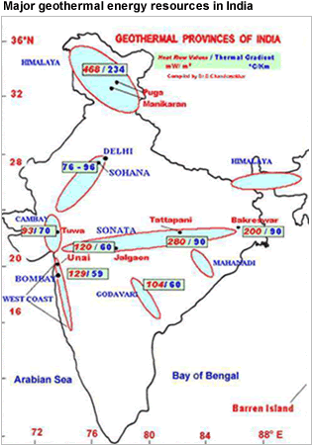

Slide 14
Biomass energy
Biomass energy is energy generated or produced by living or once-living organisms. The most common biomass materials used for energy are plants, such as corn and soy, above. The energy from these organisms can be burned to create heat or converted into electricity.
India has a potential of about 18 GW of energy from Biomass. Currently, about 32% of total primary energy used in India is derived from Biomass. More than 70% of the country's population depends upon biomass for its energy needs.
Biomass feedstock: biomass is a biologically produced matter which is composed of carbon, hydrogen and oxygen.
Examples: wood, crop residues, birch, flower or plant waste, switch grass, sugarcane, bamboo, wheat straw, corn straw, rice husk etc.

Slide 15
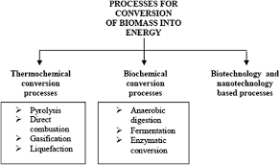
Biomass to energy conversion

Slide 16
Tidal energy
Tidal power or tidal energy is harnessed by converting energy from tides into useful forms of power, mainly electricity using various methods.
The potential capacity of electricity generation through tidal energy system in India is 10,000 MW, in which highest potential site is the Gulf of Cambay has approximate 7200 MW and this is followed by the seashore of Kutch & the Ganga delta of Sunderbans.

